Slide 1
Tableau

Slide 2
Introduction
Introduction
Tableau is a powerful data visualization and business intelligence software tool developed by Tableau Software. It allows users to create interactive and dynamic visualizations, reports, and dashboards from various data sources, making it easier to analyze and understand complex data sets.
One of the key strengths of Tableau is its ability to handle large amounts of data and process it quickly. It supports data blending and aggregation, allowing users to combine multiple data sources and summarize the information in a meaningful way.
Tableau's drag-and-drop functionality and intuitive interface make it accessible to both technical and non-technical users, enabling them to create compelling visualizations without the need for extensive programming or coding skills.
Tableau is widely used across industries and sectors for data analysis, reporting, and decision-making purposes, helping organizations uncover patterns, trends, and relationships in their data to drive informed business decisions.
Tableau is a powerful data visualization and business intelligence software tool developed by Tableau Software. It allows users to create interactive and dynamic visualizations, reports, and dashboards from various data sources, making it easier to analyze and understand complex data sets.
One of the key strengths of Tableau is its ability to handle large amounts of data and process it quickly. It supports data blending and aggregation, allowing users to combine multiple data sources and summarize the information in a meaningful way.
Tableau's drag-and-drop functionality and intuitive interface make it accessible to both technical and non-technical users, enabling them to create compelling visualizations without the need for extensive programming or coding skills.
Tableau is widely used across industries and sectors for data analysis, reporting, and decision-making purposes, helping organizations uncover patterns, trends, and relationships in their data to drive informed business decisions.

Slide 3
Uses
Uses
Ultimate skill for Data Science
User-Friendly
Apply to any Business
Fast and Easy
You don't need to do any Coding
Community is Huge
Hold the power of data
It makes it easier to understand and explain the Data Reports
Ultimate skill for Data Science
User-Friendly
Apply to any Business
Fast and Easy
You don't need to do any Coding
Community is Huge
Hold the power of data
It makes it easier to understand and explain the Data Reports

Slide 4
Features
Features
Data Connection and Integration
Drag-and-Drop Interface
Interactive Visualizations
Advanced Analytics
Dashboards and Storytelling
Collaboration and Sharing
Mobile Support

Slide 5
What is Data Visualization?
Data visualization is a graphical representation of quantitative information and data by using visual elements like graphs, charts, and maps.
Data visualization converts large and small data sets into visuals, which is easy to understand and process for humans.
Data visualization tools provide accessible ways to understand outliers, patterns, and trends in the data.
Data visualizations are used to discover unknown facts and trends

Slide 6
Why Use Data Visualization?
To make easier in understand and remember.
To discover unknown facts, outliers, and trends.
To visualize relationships and patterns quickly.
To ask a better question and make better decisions.
To competitive analyze.
To improve insights.

Slide 7
Different Products of Tableau
Tableau Desktop: Tableau Desktop is the core data visualization and analysis tool that allows users to create interactive visualizations, reports, and dashboards.
Tableau Prep: Tableau Prep is a data preparation tool that helps users clean, shape, and transform their data before analysis.
Tableau Server: Tableau Server is a web-based platform that allows users to share, collaborate, and publish Tableau visualizations and dashboards within an organization.
Tableau Online: Tableau Online is a cloud-based version of Tableau Server. It offers similar features and functionality as Tableau Server but is hosted and maintained by Tableau in the cloud.
Tableau Public: Tableau Public is a free version of Tableau that allows users to create and share visualizations publicly on the web.
Tableau Mobile: Tableau Mobile is a companion app for Tableau that enables users to access and interact with Tableau visualizations on mobile devices.

Slide 8
Download and Installation of Tableau
https://www.tableau.com/products/public/download

Slide 9
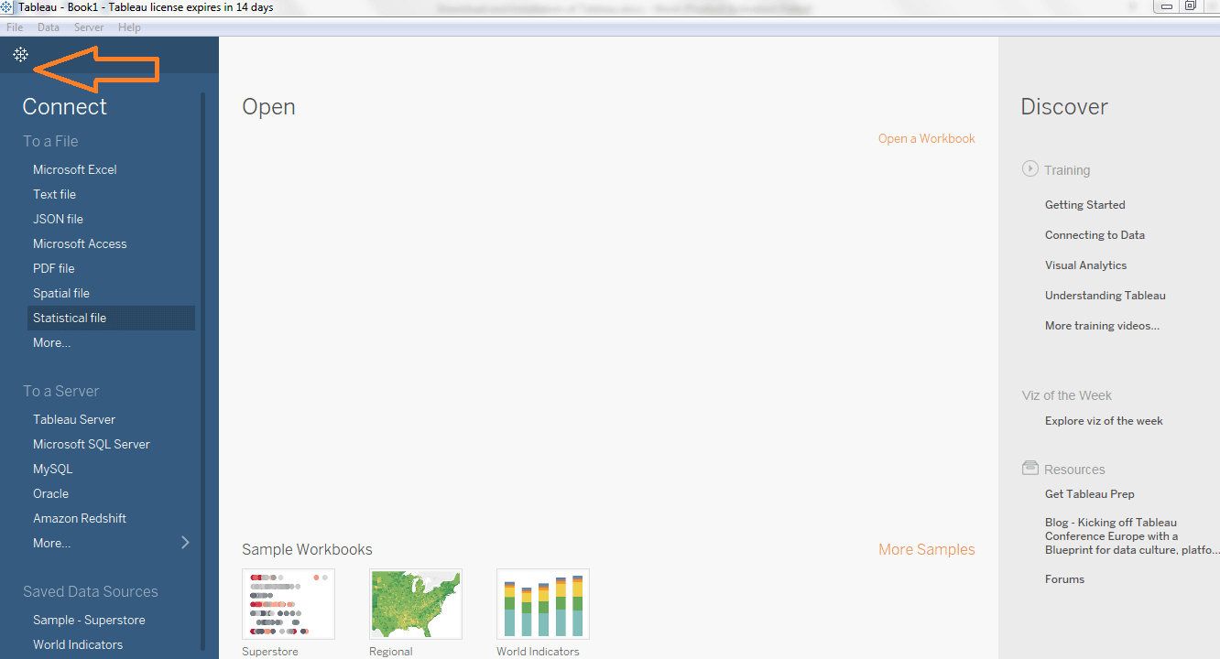
Tableau Desktop Workspace

Slide 10
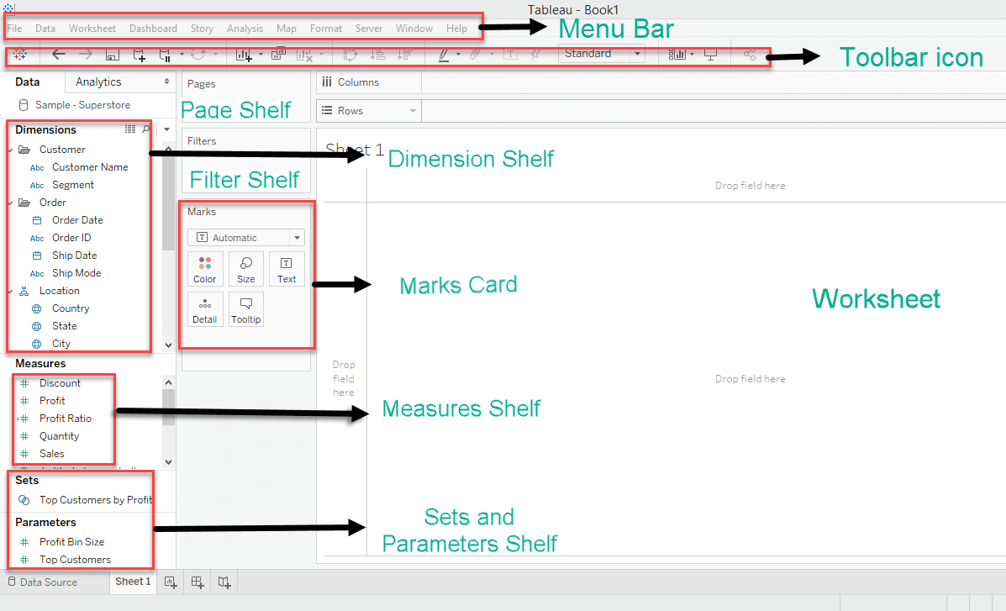
The Tableau desktop workspace consists of various elements as given below:

Slide 11
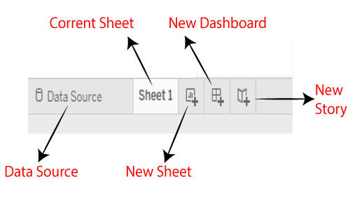
Tableau Navigation

Slide 12
Tableau Data Terminology
Dimensions: Dimensions are qualitative or categorical data fields that provide context or describe the data. Examples of dimensions include categories, names, dates, and geographical locations. In Tableau, dimensions are typically represented by discrete fields.
Measures: Measures are quantitative or numerical data fields that can be aggregated, calculated, or summarized. They represent the values that you want to analyze and visualize. Examples of measures include sales revenue, profit, quantity, and average ratings. In Tableau, measures are typically represented by continuous fields.
Aggregation: Aggregation refers to the process of combining multiple data values into a single value based on a specific function or calculation. Common aggregation functions include sum, average, count, minimum, and maximum. Aggregations are used to summarize and analyze data at different levels of granularity.

Slide 13
Calculated Field: A calculated field is a new field that you create in Tableau by applying a formula or expression to existing fields. Calculated fields allow you to perform custom calculations and manipulate the data to derive new insights. They can be based on mathematical operations, logical conditions, or string manipulations, among others.
Filters: Filters in Tableau are used to narrow down the data displayed in a visualization based on specific conditions or criteria. You can apply filters to dimensions or measures to focus on subsets of the data that are relevant to your analysis. Filters help in exploring different aspects of data and uncovering insights.
Hierarchies: Hierarchies in Tableau represent the organization of data fields into levels of detail. They allow you to drill down or roll up the data to different levels of granularity. For example, a time hierarchy may include levels such as year, quarter, month, and day, enabling users to analyze data at various time intervals

Slide 14
Joins and Blends: Joins and blends are methods used to combine data from multiple tables or data sources in Tableau. Joins are used when you have related tables with a common field, and you want to merge them based on that field. Blends are used when you have separate data sources that you want to connect and analyze together.
Parameters: Parameters are dynamic values that you can create in Tableau to allow users to change certain aspects of the analysis without modifying the underlying data or calculations. Parameters are useful for creating interactive dashboards where users can adjust filters, thresholds, or other variables to explore different scenarios.
Dashboards: Dashboards in Tableau are interactive collections of visualizations, filters, and other components that provide a consolidated view of the data. Dashboards allow users to analyze and explore multiple data points simultaneously and facilitate the communication of insights to a wider audience.
Story: Tableau Stories are a feature that allows you to combine multiple visualizations and dashboards into a sequence or narrative. Stories help in presenting a cohesive data-driven narrative by guiding viewers through a series of visualizations with annotations, captions, and other textual elements.

Slide 15
Data Types in Tableau
Date values
Text values
Numerical values
Date and time values
Boolean values (True or False conditions )
Geographic values (longitude and latitude used for maps)

Slide 16
Data Aggregation in Tableau
Maximum
Median
Count
Sum
Minimum
CountDistinct
Average
Variance,

Slide 17
Various file extensions
Tableau Workbook (.twb): This is the default file extension for Tableau workbooks. A Tableau workbook contains one or more worksheets, dashboards, and stories, along with the data connections and visualizations.
Tableau Packaged Workbook (.twbx): This file type is a packaged version of a Tableau workbook that includes all the necessary data and resources, such as images or extracts, in a single file. It allows you to share workbooks with others without worrying about missing data or external dependencies.
Tableau Data Source (.tds): A Tableau data source file contains the connection information and metadata for a specific data source, but it doesn't include the actual data. It allows you to create reusable connections to data, which can be shared across multiple workbooks.
Tableau Data Extract (.tde): A Tableau data extract is a compressed file that stores a subset or an aggregated version of the data from a data source. Extracts are used to improve performance by optimizing the data for Tableau's analytical engine. Extracts can be created from various data sources and are stored with a .tde extension

Slide 18
Tableau Packaged Data Source (.tdsx): This file type is a packaged version of a Tableau data source that includes both the connection information and the actual data extract. It allows you to share a self-contained data source with others, ensuring data integrity and consistency.
Tableau Bookmark (.tbm): A Tableau bookmark file allows you to save a specific view or state of a Tableau workbook for quick reference or sharing. It contains a link to the workbook along with the selected sheet, filter settings, and other parameters.
Tableau Template (.tpt): A Tableau template file is a pre-designed workbook layout that includes formatting, visualizations, and data source connections. It allows you to create consistent and standardized reports by applying the same template to multiple workbooks.
Tableau Map Source (.tms): Tableau map source files contain custom map layers or spatial data that can be used to enhance geospatial analysis and visualization in Tableau.
Tableau Preference

Slide 19
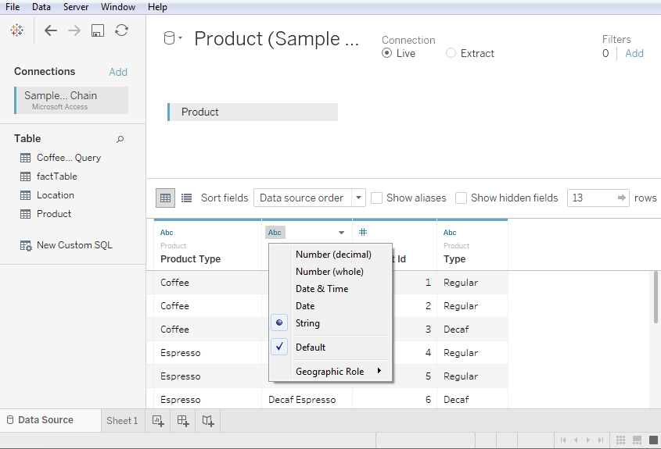
Changing the Data Type

Slide 20
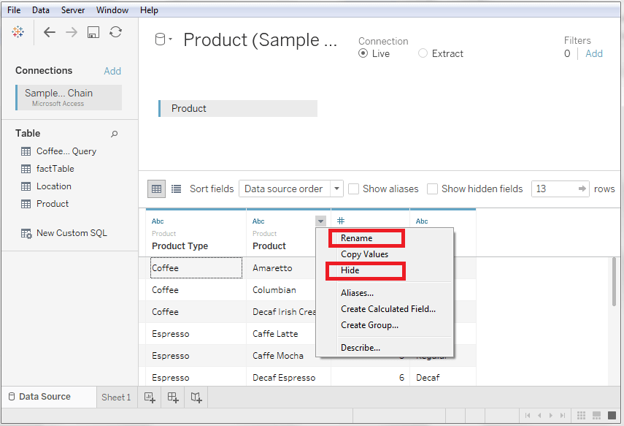
Renaming and Hiding

Slide 21
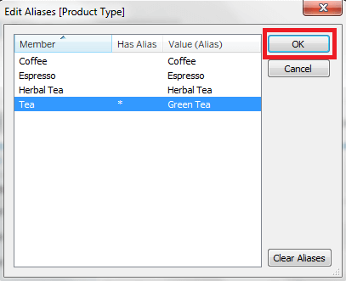
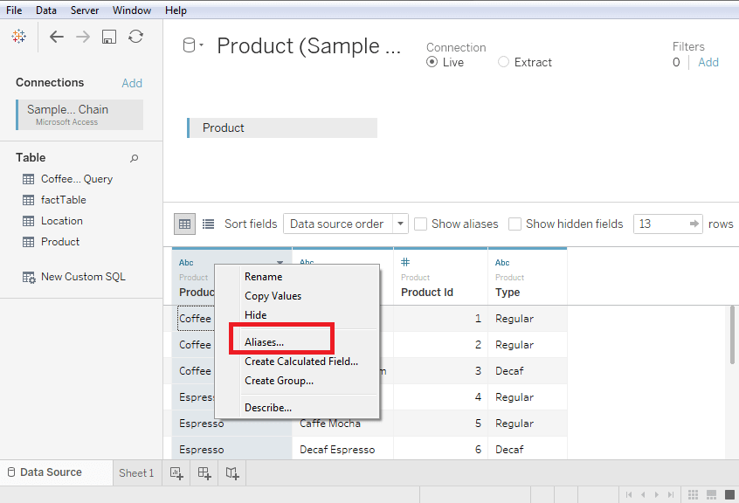
Column Alias

Slide 22
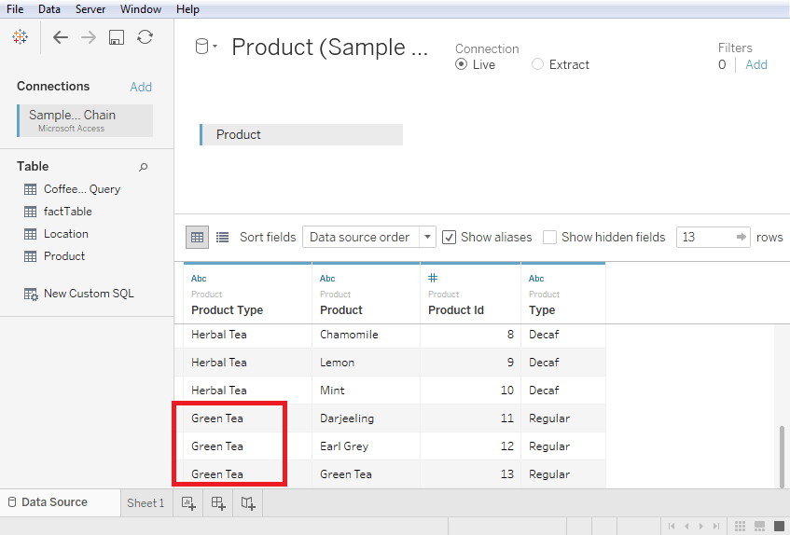

Slide 23
Dimension and measure in tableau
Dimensions: Dimensions are categorical data fields that provide descriptive attributes or categories for your data. They typically contain qualitative or discrete information and help define the structure and context of your analysis
Measures: Measures are quantitative or numeric data fields that represent values that can be aggregated or analyzed mathematically. They provide the basis for calculations and are used to answer questions or perform calculations on your data.

Slide 24
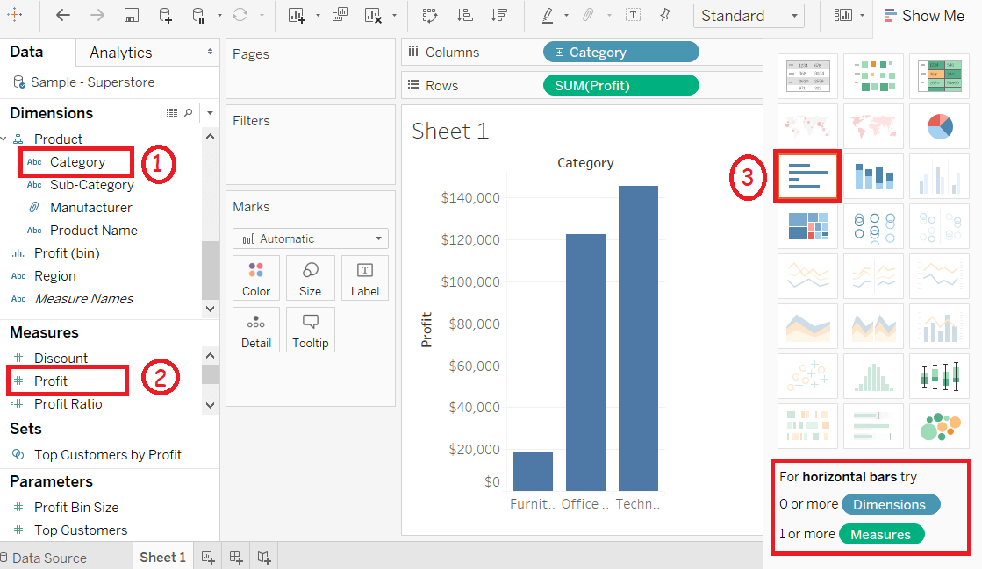
Tableau Bar Chart

Slide 25
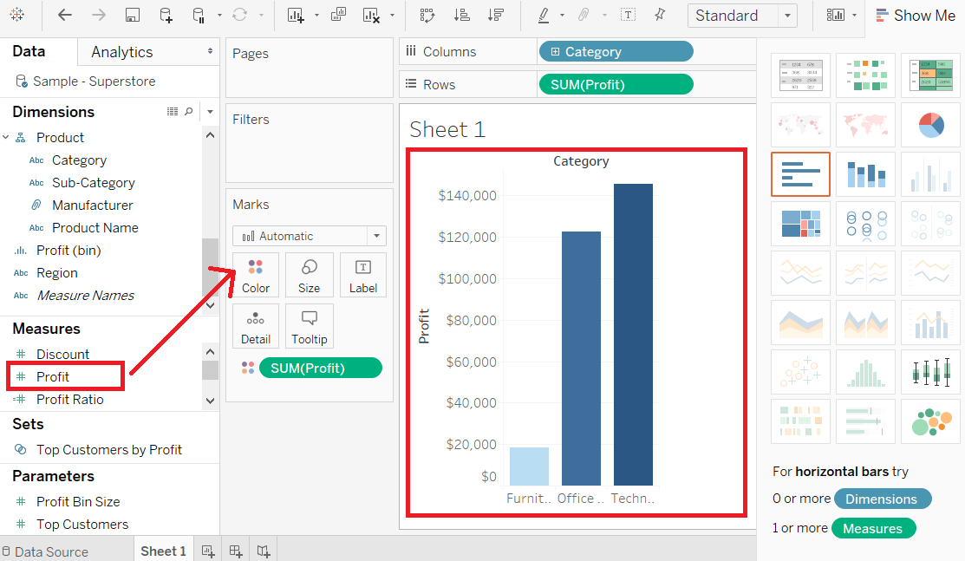
Bar Chart with Color Range

Slide 26
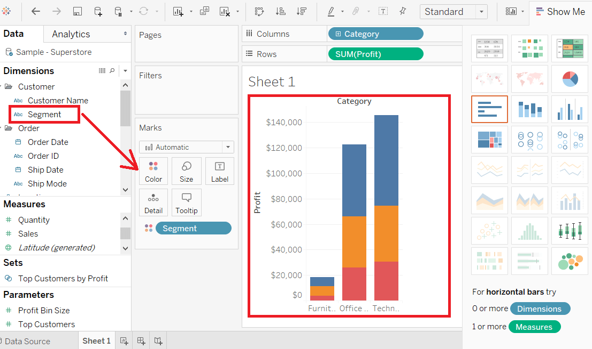
Stacked Bar Chart

Slide 27
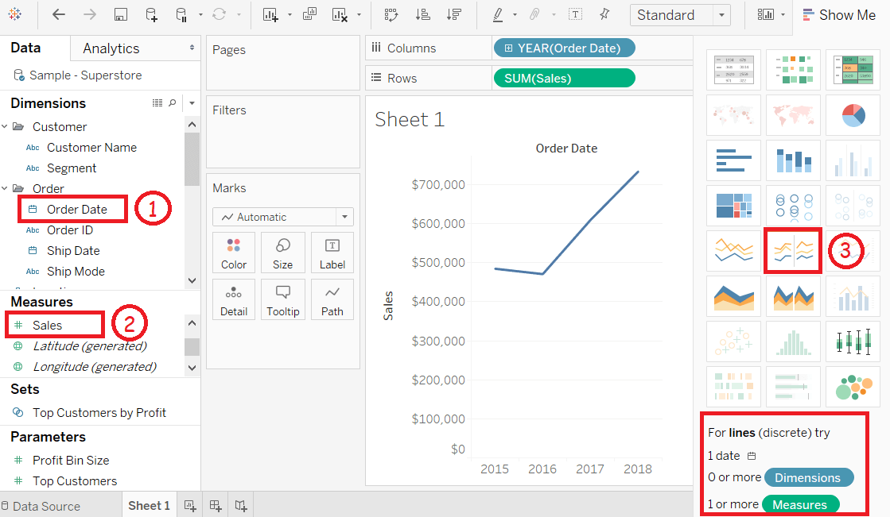
Tableau Line Chart

Slide 28
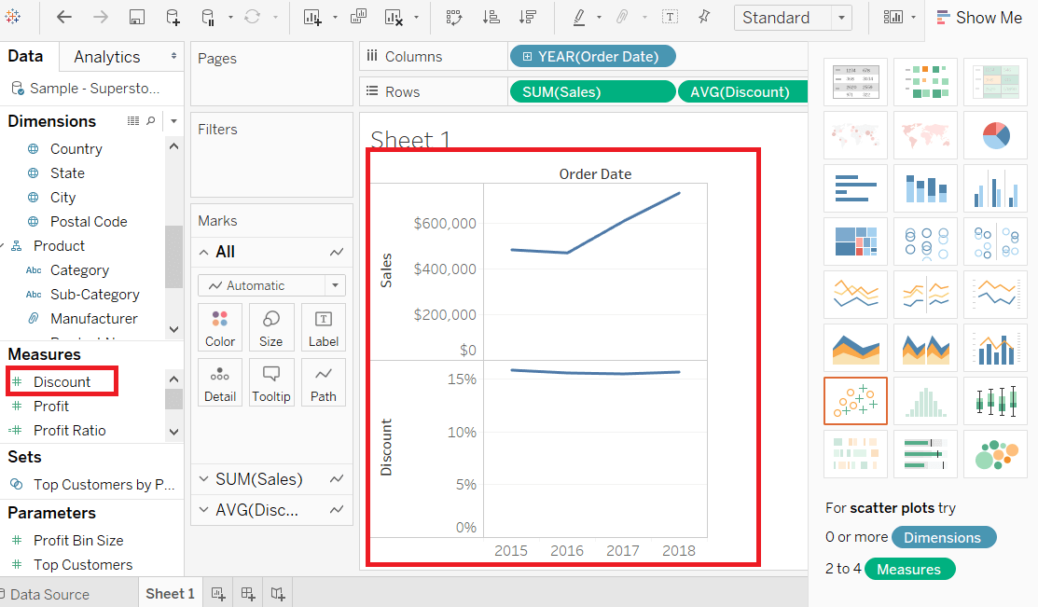
Multiple Measure Line Chart

Slide 29
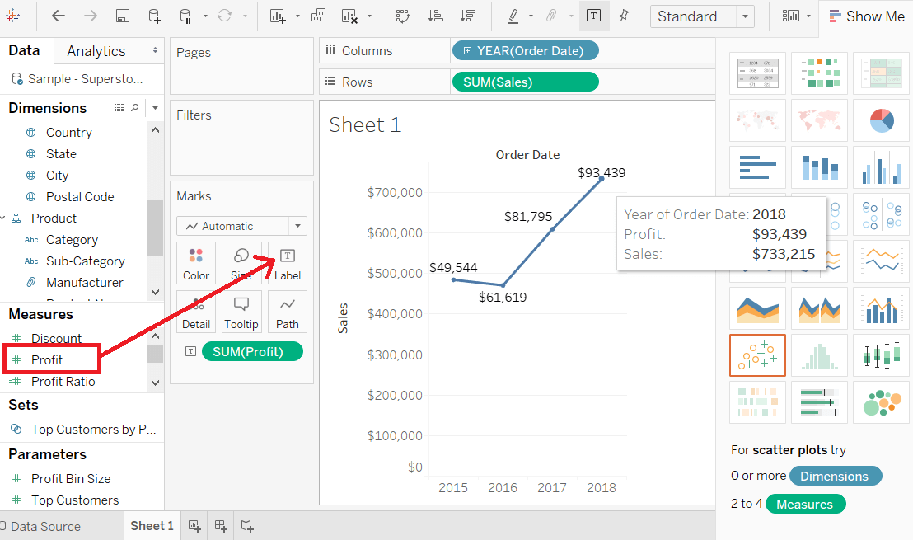
Line Chart with Label

Slide 30
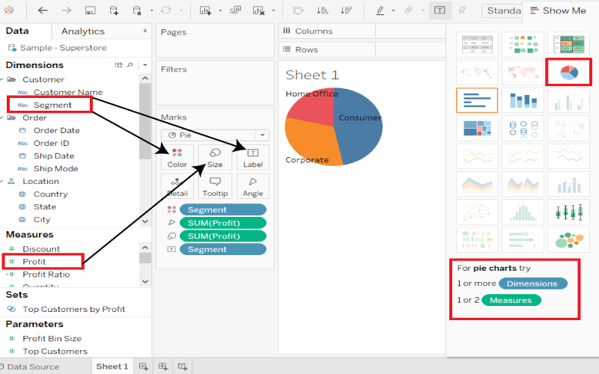
Tableau Pie Chart

Slide 31
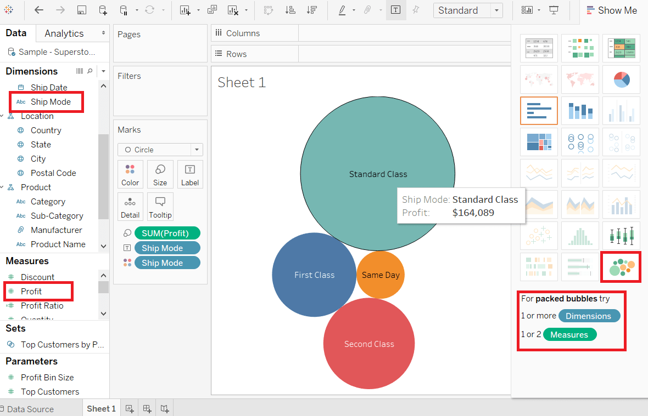
Tableau Bubble Chart

Slide 32
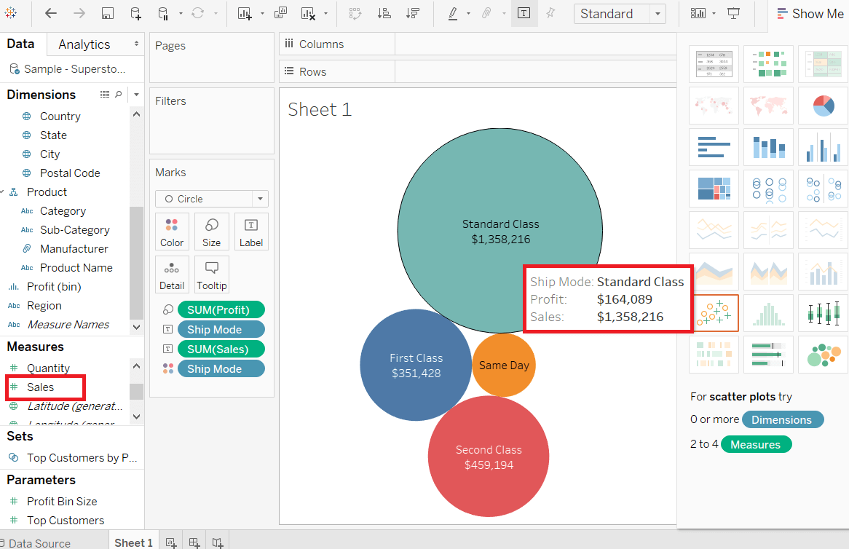
Bubble Chart with Measure Values

Slide 33
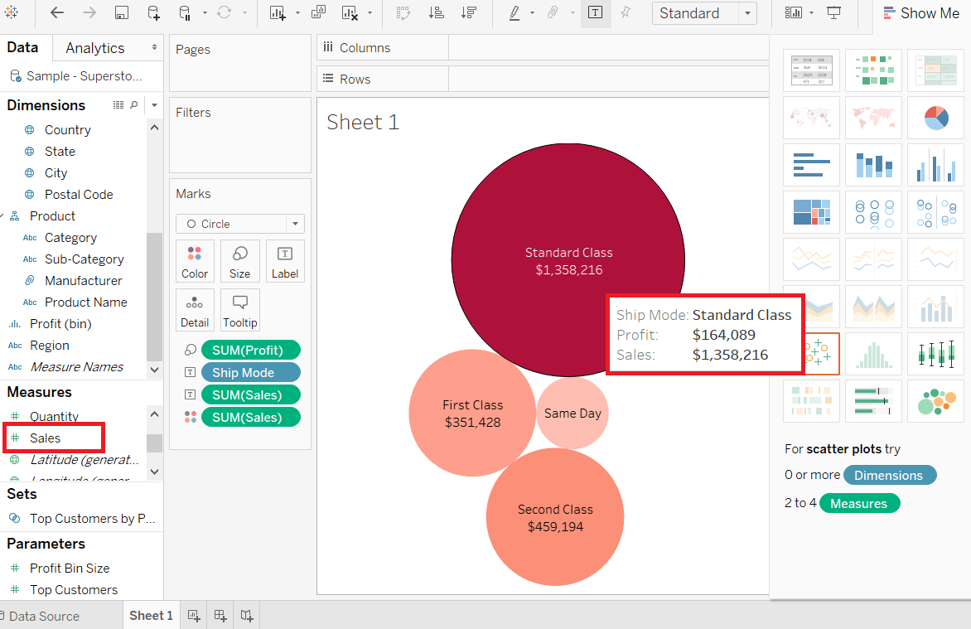
Bubble Chart with Measure Color

Slide 34
Tableau Gantt Chart
A Gantt chart is used for the comparison of data between categories. Also, it can be used to identify the time taken for each process. It shows the progress of the value of a task over some time. It is broadly used in project management and other types of variation study over some time. Gantt chart takes at least a dimension and a measure in addition to the time dimension.

Slide 35
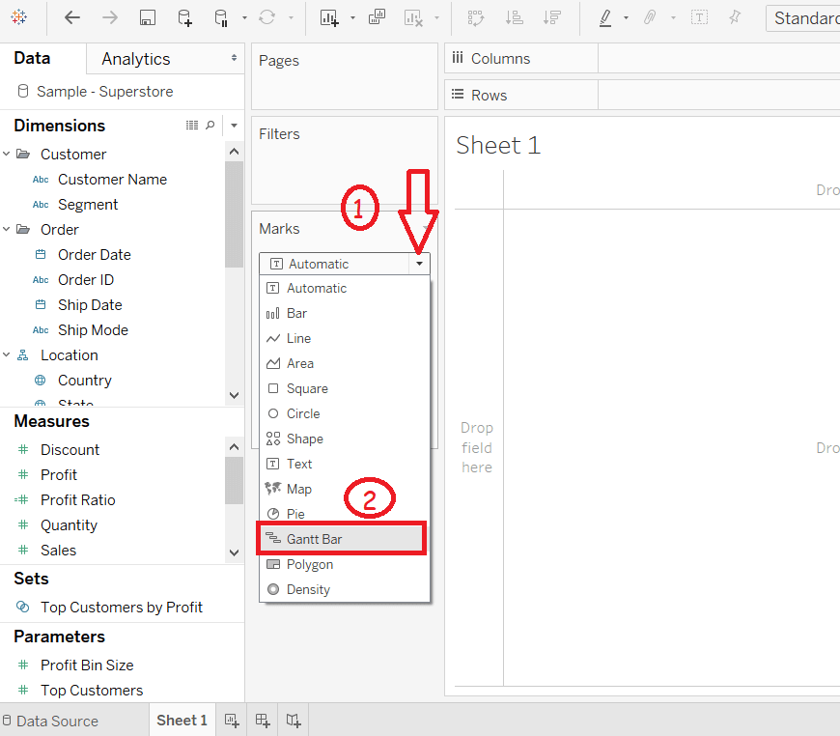

Slide 36
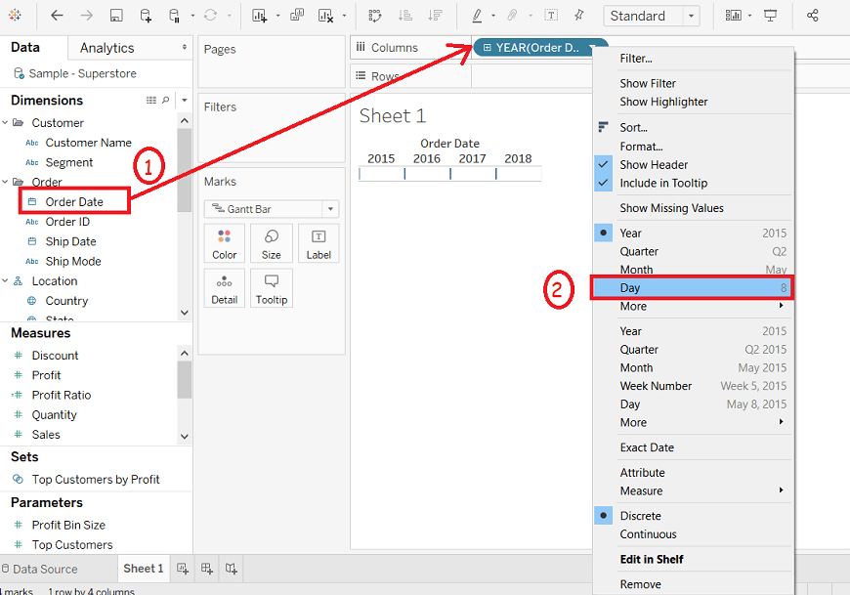

Slide 37
Filters
In Tableau, filters are a powerful feature that allow you to control which data is displayed in your visualizations and dashboards. Filters enable you to focus on specific subsets of your data or exclude certain data points based on specified criteria. There are different types of filters available in Tableau, each serving a different purpose. Here are some commonly used filters in Tableau:
1.Selection filter
2.Wild card filter
3.Condition filter
4.Top/Bottom N filter

Slide 38
Set,Group,Hierarchy,Parameter in tableau
Sets: A set is a custom subset of data created based on specific conditions or rules. Sets can be dynamic or static. Dynamic sets update automatically when the underlying data changes, while static sets remain fixed regardless of data changes. Sets allow you to focus on specific data points or create comparisons between different subsets of your data. For example, you can create a set to identify the top 10 customers by sales or a set to capture all products with sales above a certain threshold.
Groups: Groups in Tableau are created by combining multiple members of a dimension into a single item. It allows you to consolidate similar dimension members for easier analysis and visualization. For example, you can group different product categories into a single group called "Other" to simplify the view. Groups are often used to aggregate or summarize data at a higher level and provide more concise visualizations.

Slide 39
Hierarchies: Hierarchies are created by combining multiple dimensions into a single structure, enabling drill-down analysis. You can create hierarchical relationships between dimensions to establish parent-child relationships. For example, you can create a hierarchy that includes the dimensions "Country," "Region," and "City," allowing you to drill down from the country level to the city level. Hierarchies provide a way to navigate through different levels of detail in your data.
Parameters: Parameters are dynamic controls that allow users to input values and change certain aspects of a visualization. They act as placeholders for values that can be modified by the user, such as selecting a specific date range, changing a calculation, or adjusting a threshold. Parameters enable interactivity and allow users to explore different scenarios or make data-driven decisions within a visualization

Slide 40
Tableau Functions
Tableau provides various functions to help you manipulate and analyze your data effectively. These functions allow you to transform, aggregate, and calculate values within your datasets.
Aggregation Functions
Mathematical Functions
String Functions
Date and Time Functions
Logical Functions
Statistical Functions

Slide 41
Mathematical Functions
1.ABS
Returns the absolute value of the given number.
ABS(number)
Eg: ABS(-12)=12
2.CEILING
Rounds a number to the nearest integer of equal or greater value.
CEILING(number)
CEILING(3.1415) = 4

Slide 42
3. DIV
Returns the integer part of a division operation, in which integer 1 is divided by integer 2.
DIV(integer 1, integer 2)
DIV(13,6)=2
4. FLOOR
Rounds a number to the nearest integer of equal or lesser value.
FLOOR(number)
FLOOR(4.53)=4

Slide 43
5.MAX
Returns the maximum of the two arguments, which must be of the same type.
MAX(number, number)
MAX(4,7)
MAX(Sales,Profit)
MAX([First Name],[Last Name])

Slide 44
6.MIN
Returns the minimum of the two arguments, which must be of the same type
MIN(number, number)
MIN(number, number)
MIN(4,7)
MIN(Sales,Profit)
MIN([First Name],[Last Name])

Slide 45
7.POWER
Raises the number to the specified power.
POWER(number, power)
POWER(5,2) = 25
8.SQUARE
Returns the square of a number.
SQUARE(number)
SQUARE(5)=25

Slide 46
8.SQRT
Returns the square root of a number.
SQRT(number)
SQRT(36)=6
9.ZN
Returns the expression if it is not null, otherwise returns zero. Use this function to use zero values instead of null values.
ZN(expression)

Slide 47
String Functions
1. ASCII
Returns the ASCII code for the first character of string.
ASCII(sstring)
ASCII(‘B’)=66
2.CHAR
Returns the character encoded by the ASCII code number.
CHAR(number)
CHAR(65)=’A’

Slide 48
3. CONTAINS
Returns true if the given string contains the specified substring.
CONTAINS(string,substring)
CONTAINS(“Calculation”, “alcu”) = true
4.ENDSWITH
Returns true if the given string ends with the specified substring. Trailing white spaces are ignored.
ENDSWITH(string,substring)
ENDSWITH(“Tableau”,”aeu”)=False

Slide 49
5.FIND
Returns the index position of substring in string, or 0 if the substring isn't found. If the optional argument start is added, the function ignores any instances of substring that appear before the index position start. The first character in the string is position 1.
FIND(string,substring,[start])
FIND (“calculation”,”a”)=2
6.FINDNTH
Returns the position of the nth occurrence of substring within the specified string, where n is defined by the occurrence argument.
FINDNTH(string,substring,occurence)
FINDNTH(“calculation”,”a”,2)=7

Slide 50
7.LEFT
Returns the left-most number of characters in the string.
LEFT(string,number)
LEFT(“calculation”,4)=calc
8.LEN
Returns the length of the string.
LEN(string)
LEN(“Tableau”)=7

Slide 51
9.LOWER
Returns string, with all characters lowercase.
LOWER(string)
LOWER(“TECHOLAS”)=techolas
10.LTRIM
Returns the string with any leading spaces removed.
LTRIM(string)
LTRIM(“ machine“)=”machine”

Slide 52
11.MAX
With strings, MAX finds the value that is highest in the sort sequence defined by the database for that column.
MAX(string1,string2)
MAX(“Tableau”,”Powerbi”)=Tableau
12.MID
Returns the string starting at index position start. If the optional argument length is added, the returned string includes only that number of characters.
MID(string,start,[length])
MID(“Analyst”,3,2)=al

Slide 53
13.MIN
Returns the minimum of a and b (which must be of the same type). This function is usually used to compare numbers, but also works on strings
MIN(string,string)
MIN(“Tableau”,”Powerbi”)=Powerbi

Slide 54
14.PROPER
Converts a text string so the first letter of each word is capitalized and the remaining letters are in lowercase.
PROPER(string)
PROPER(“PRoper name”)=Proper Name
15.REPLACE
Searches string for substring and replaces it with replacement. If substring is not found, the string is not changed.
REPLACE(string,substring,replacement)
REPLACE(“Data Analyst”,”Data”,”Business”)=Business Analyst

Slide 55
16.RIGHT
Returns the right-most number of characters in string.
RIGHT(string,length)
RIGHT(“Calculation”,4)=tion
17.RTRIM
Returns string with any trailing spaces removed.
RTRIM(string)
RTRIM(“Android ”)=”Android”

Slide 56
18.SPACE
Returns a string that is composed of the specified number of repeated spaces.
SPACE(number)
SPACE(5)=” “
19.STARTSWITH
Returns true if string starts with substring. Leading white spaces are ignored.
STARTSWITH(string,substring)
STARTSWITH(“North West”,”North”)=TRUE

Slide 57
20.TRIM
Returns the string with leading and trailing spaces removed.
TRIM(string)
TRIM(“ Analyst ”)=”Analyst”
21.UPPER
Returns string, with all characters uppercase.
UPPER(string)
UPPER(“AnaLyst”)=ANALYST

Slide 58
Logical Functions
1.IN
Returns TRUE if any value in <expr1> matches any value in <expr2>.The values in <expr2> can be a set, list of literal values, or combined field.
<expr1> IN <expr2>
SUM([Cost]) IN (1000, 15, 200)
2.AND
Performs a logical conjunction on two expressions.
IF <expr1> AND <expr2> THEN <then> END
IF (ATTR([Market]) = "New Business" AND SUM([Sales]) > [Emerging Threshold] )THEN "Well Performing"

Slide 59
3.CASE
Performs logical tests and returns appropriate values. The CASE function evaluates expression, compares it to a sequence of values, value1, value2, etc., and returns a result. When a value that matches expression is encountered, CASE returns the corresponding return value. If no match is found, the default return expression is used. If there is no default return and no values match, then Null is returned.
CASE <expression> WHEN <value1> THEN <return1> WHEN <value2> THEN <return2> ... ELSE <default return> END
CASE [Region] WHEN 'West' THEN 1 WHEN 'East' THEN 2 ELSE 3 END

Slide 60
4.ELSE
Tests a series of expressions returning the <then> value for the first true <expr>.
IF <expr> THEN <then> ELSE <else> END
If [Profit] > 0 THEN 'Profitable' ELSE 'Loss' END
5.ELSEIF
Tests a series of expressions returning the <then> value for the first true <expr>.
IF <expr> THEN <then> [ELSEIF <expr2> THEN <then2>...] [ELSE <else>] END
IF [Profit] > 0 THEN 'Profitable' ELSEIF [Profit] = 0 THEN 'Breakeven' ELSE 'Loss' END

Slide 61
6.END
Tests a series of expressions returning the <then> value for the first true <expr>. Must be placed at the end of an expression.
IF <expr> THEN <then> [ELSEIF <expr2> THEN <then2>...] [ELSE <else>] END
IF [Profit] > 0 THEN 'Profitable' ELSEIF [Profit] = 0 THEN 'Breakeven' ELSE 'Loss' END
7.IF
Tests a series of expressions returning the <then> value for the first true <expr>.
IF <expr> THEN <then> [ELSEIF <expr2> THEN <then2>...] [ELSE <else>] END
IF [Profit] > 0 THEN 'Profitable' ELSEIF [Profit] = 0 THEN 'Breakeven' ELSE 'Loss' END

Slide 62
8.IFNULL
Returns <expr1> if it is not null, otherwise returns <expr2>.
IFNULL(expr1, expr2)
IFNULL([Profit], 0)
9.ISDATE
Returns true if a given string is a valid date.
ISDATE(string)
ISDATE("2004-04-15") = True

Slide 63
10.ISNULL
Returns true if the expression is NULL (does not contain valid data).
ISNULL(expression)
ISNULL([Total])
11.MAX
Returns the maximum of a single expression across all records or the maximum of two expressions for each record.
MAX(expression) or Max(expr1, expr2)
MAX([Profit])

Slide 64
12.MIN
Returns the minimum of an expression across all records or the minimum of two expressions for each record.
MIN(expression) or MIN(expr1, expr2)
MIN([Profit])
13.NOT
Performs logical negation on an expression.
IF NOT <expr> THEN <then> END
IF NOT [Profit] > 0 THEN "Unprofitable" END

Slide 65
14.OR
Performs a logical disjunction on two expressions.
IF <expr1> OR <expr2> THEN <then> END
IF [Profit] < 0 OR [Profit] = 0 THEN "Needs Improvement" END
15.THEN
Tests a series of expressions returning the <then> value for the first true <expr>.
IF <expre> THEN <then> [ELSEIF ,expr2> THEN <then2>...] [ELSE <else>] END
IF [Profit] > 0 THEN 'Profitable' ELSEIF [Profit] = 0 THEN 'Break even' ELSE 'unprofitable' END

Slide 66
16.WHEN
Finds the first <value> that matches <expr> and returns the corresponding <return>.
CASE <expr> WHEN <Value1> THEN <return1> ... [ELSE <else>] END
CASE [RomanNumberal] WHEN 'I' THEN 1 WHEN 'II' THEN 2 ELSE 3 END
17.ZN
Returns <expression> if it is not null, otherwise returns zero.
ZN(expression)
ZN([Profit])

